Slide 1
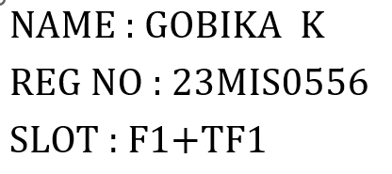

DEEP LEARNING
Integrity Agent
A Multi-Modal AI System for Detecting Fake News, Dark Patterns, and Deepfake Images
delivering a unified trust score across text, web content, and visual media.
AI INTEGRITY
MULTI-MODAL

Slide 2



The Challenge : Problem statement
A Digital World Under Threat
Misinformation, deceptive design, and synthetic media are eroding trust at an unprecedented scale. A unified, automated solution is no longer optional it's essential.
Fake News Proliferation
Dark Pattern Manipulation
Deepfake Image Fraud
Misinformation spreads up to six times faster than factual content on social platforms, influencing public opinion, elections, and public health decisions at scale.
Websites embed deceptive UX patterns hidden charges, forced continuity, misdirection designed to coerce users into unintended actions without their informed consent.
AI-generated and tampered images are weaponized for identity fraud, political manipulation, and disinformation campaigns, making visual verification critically difficult.

Slide 3
SOLUTION
Introducing Integrity Agent
Integrity Agent is a unified, multi-modal AI platform that independently analyzes text, website content, and images then synthesizes findings into a single, interpretable Integrity Score.
User Inputs
Preprocessing
By combining NLP, deep learning, and computer vision into one cohesive system, Integrity Agent empowers users, platforms, and organizations to automatically flag manipulated or misleading digital content before it causes harm.
Multi-Modal AI
Integrity Score

Slide 4


Data Foundation
Datasets Powering Each Model
Data from three specialized datasets forms the backbone of the model training pipeline.
Fake News Dataset
44,921 total records across two balanced classes: 21,418 real and 23,503 fake news articles. Each record contains full text content and a binary Real/Fake label ideal for training a robust neural network classifier.
Dark Pattern Dataset
2,347 labeled sentences extracted from real website interfaces. Each entry is tagged as either a Dark Pattern or Normal text, enabling binary classification of deceptive UX copy with Word2Vec embeddings.
CASIA Deepfake Dataset
The CASIA Image Manipulation Dataset contains authentic (Au) and tampered (Tp) images used to train a MobileNetV2 CNN model. It includes a total of 12,614 images, with 10,092 for training and 2,522 for validation, classified as fake (0) and real (1).

Slide 5

Methodology
Model Architecture & Training Pipeline
Text-Based Models
Image-Based Model
Fake News Detection
Deepfake Detection with MobileNetV2
Tokenization, stopword removal, text cleaning
Word embeddings / vectorization for feature extraction
Dense layers + ReLU + Dropout + Sigmoid output
Optimizers compared: Adam, SGD, RMSprop
Transfer learning on ImageNet-pretrained MobileNetV2
Input images resized to 224×224, pixel values normalized
Global Average Pooling → Dense (128) → Dropout → Sigmoid
Fine-tuning of final layers on CASIA dataset
Output: probability score for Real vs. Fake
Dark Pattern Detection
Word2Vec embeddings for semantic representation
Fully connected layers: Dense → Dropout → Dense → Dense
Binary classification output (Dark / Not Dark)
All three models are trained independently, then combined at inference time to produce the unified Integrity Score.

Slide 6
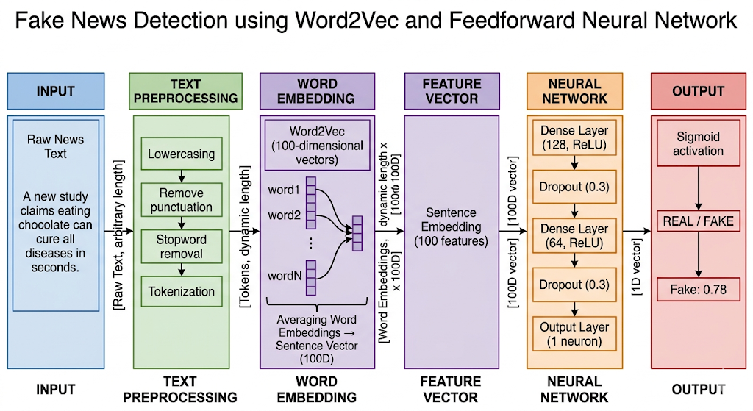


Slide 7
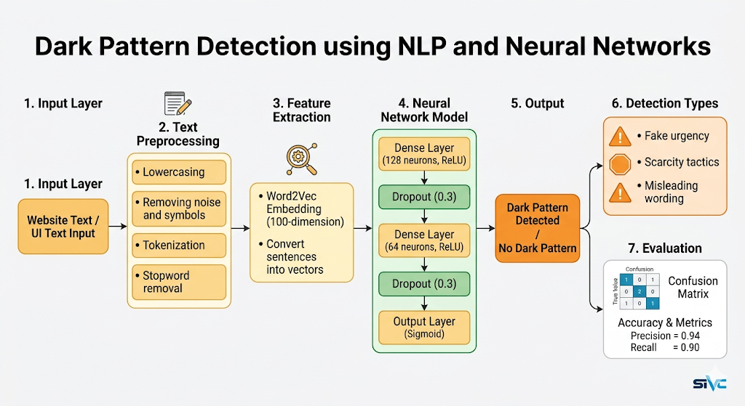


Slide 8
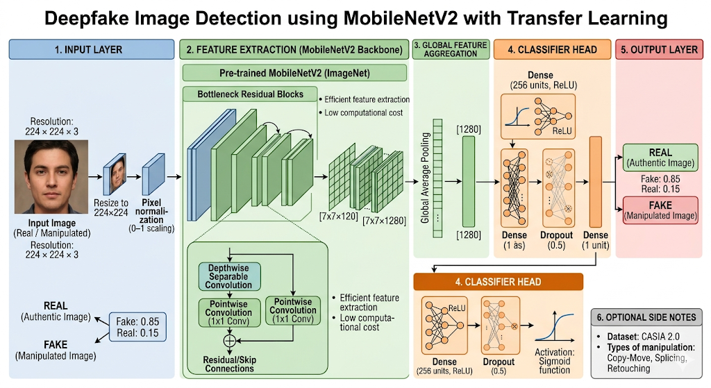

Slide 9
Evaluation
Performance Metrics & Optimizer Comparison
Each model is rigorously evaluated using a comprehensive suite of metrics to ensure reliability and generalizability across real-world content.
Optimizer Comparison
Three gradient descent optimizers were benchmarked to identify the best convergence behavior for each model type:
Accuracy
Precision
Adam
Overall correct prediction rate across all classes.
Fraction of predicted positives that are truly positive.
Adaptive learning rate; fastest convergence and a strong default baseline.
SGD
Slower convergence, more stable, and better generalization with tuning.
Recall
F1 Score
Fraction of actual positives correctly identified.
Harmonic mean of precision and recall; key for imbalanced data.
RMSprop
Handles noisy gradients, works well with non-stationary data, and is efficient for complex models.

Slide 10
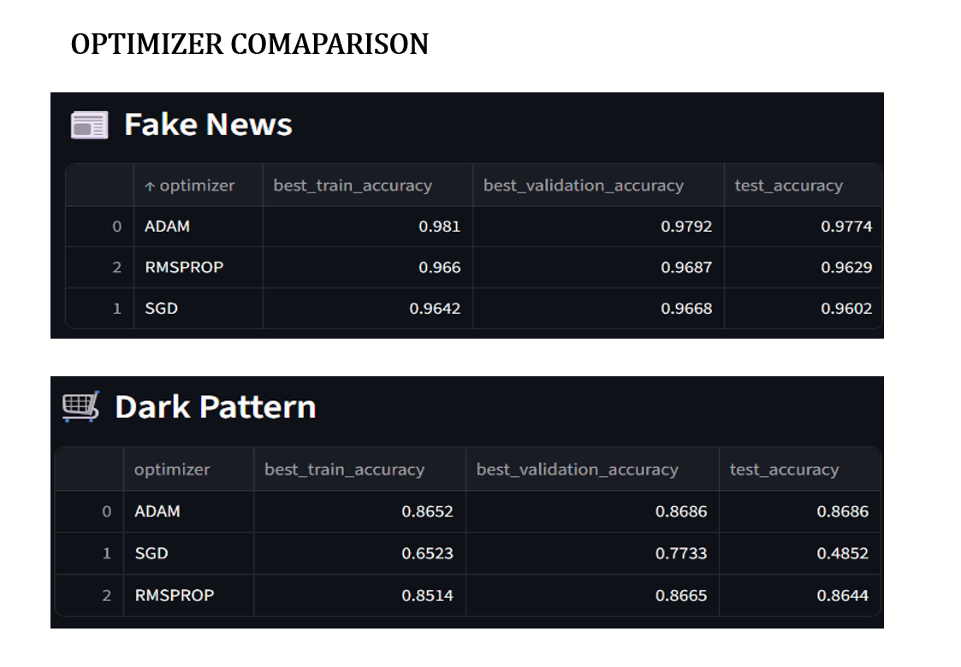


Slide 11
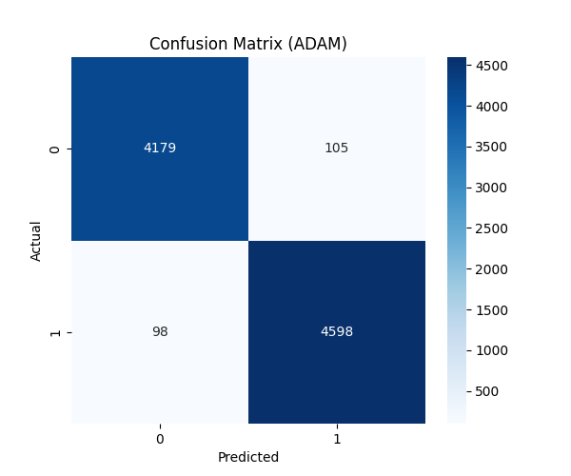
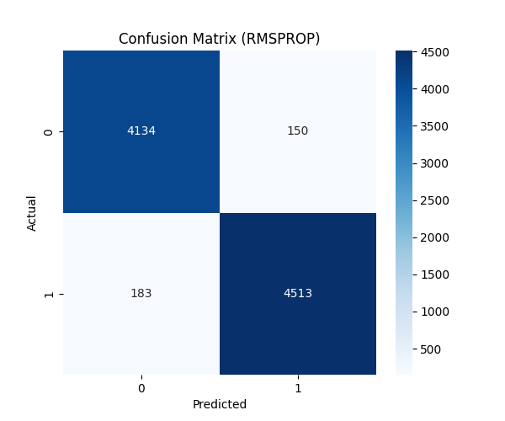



Slide 12
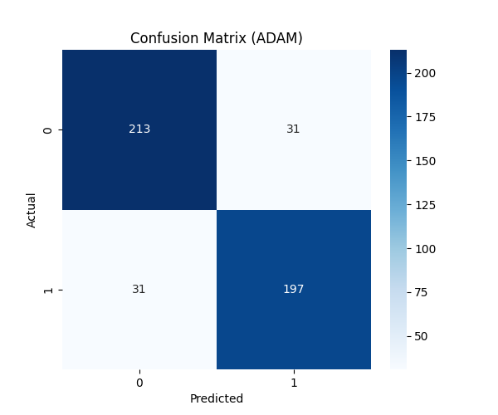
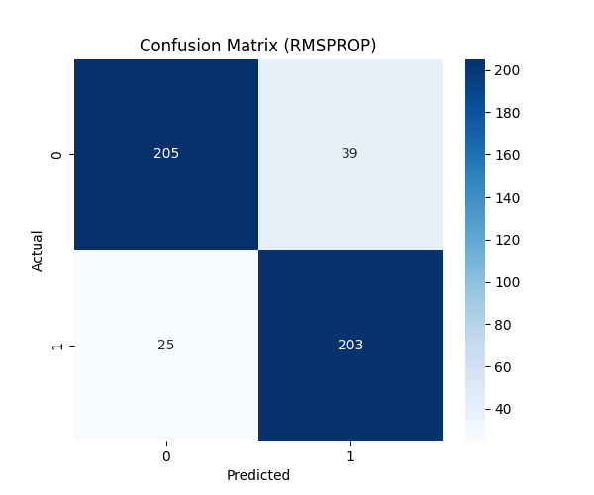
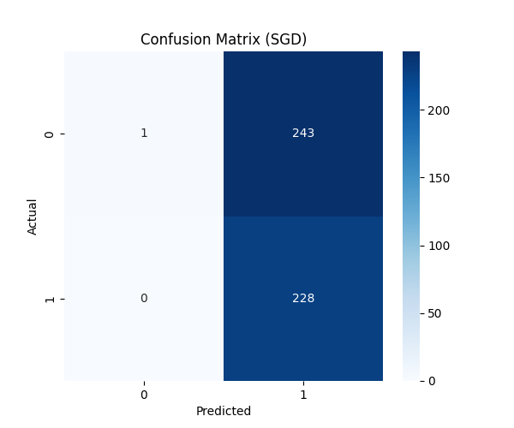

Slide 13
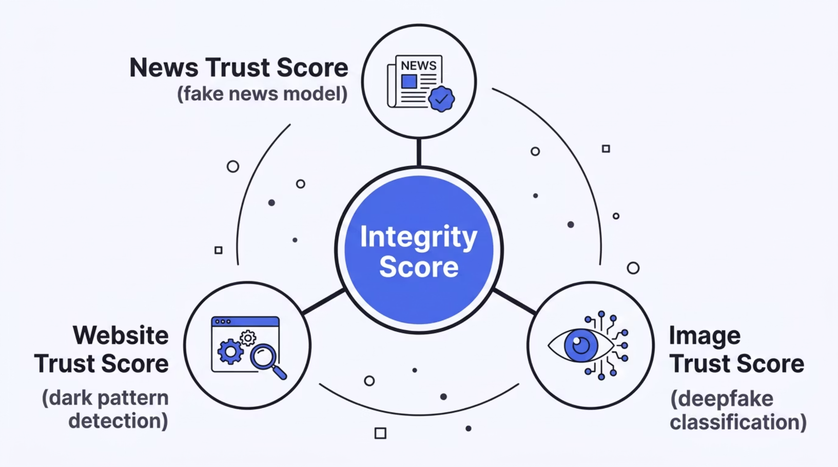

Core Output
The Unified Integrity Score
The Integrity Score is the system's signature output — a single, weighted composite metric synthesizing predictions from all three models into one interpretable trust indicator.
80–100 · Highly Trustworthy
60–80 · Mostly Reliable
40–60 · Mixed / Suspicious
Content passes all three checks. Safe to consume and share.
Minor anomalies detected. Exercise standard caution.
Notable concerns flagged. Manual review recommended.
0–40 · Likely Manipulated
High-confidence manipulation detected. Do not trust or share.

Slide 14

Application
Streamlit Web Interface
Integrity Agent is delivered through an interactive Streamlit web application that makes integrity analysis immediate, transparent, and easy to use. The interface reduces cognitive load while still exposing the logic behind each result, helping users move from input to insight with minimal friction.
Text Input & Analysis
Users can paste articles, headlines, or website copy directly into the app for instant analysis. The pipeline normalizes the text, extracts features, and returns prediction labels and confidence scores to support quick review.
Image Upload & Detection
Uploaded images are processed through a MobileNetV2-based detector that classifies them as real or fake. Preprocessing ensures consistent inference, making it useful for screenshots, social media images, and other suspicious visuals.
Navigation & Visualization
A structured sidebar guides users through input, evaluation, and result review. Visual indicators and score summaries make outputs easy to interpret without requiring knowledge of the underlying model architecture.

Slide 15
Technology Stack
Tools & Frameworks
Why This Stack?
Core ML/DL
NLP & Embeddings
Each tool was chosen for its maturity, community support, and suitability for rapid prototyping without sacrificing production-quality performance.
TensorFlow / Keras — model architecture, training loops, and transfer learning. Scikit-learn — preprocessing pipelines, evaluation metrics, and confusion matrices.
Gensim (Word2Vec) — semantic word embeddings for the dark pattern model. Standard tokenization and vectorization for the fake news classifier.
Python
Universal ML language with rich ecosystem
Computer Vision
Frontend & Data
OpenCV — image loading, resizing to 224×224, and pixel normalization prior to MobileNetV2 inference. Essential for consistent preprocessing across the CASIA dataset.
Streamlit — interactive web UI with no frontend code required. Pandas & NumPy — data manipulation, cleaning, and numerical operations throughout the pipeline.
MobileNetV2
Lightweight CNN, ideal for fast inference
Streamlit
Zero-friction deployment for ML apps

Slide 16
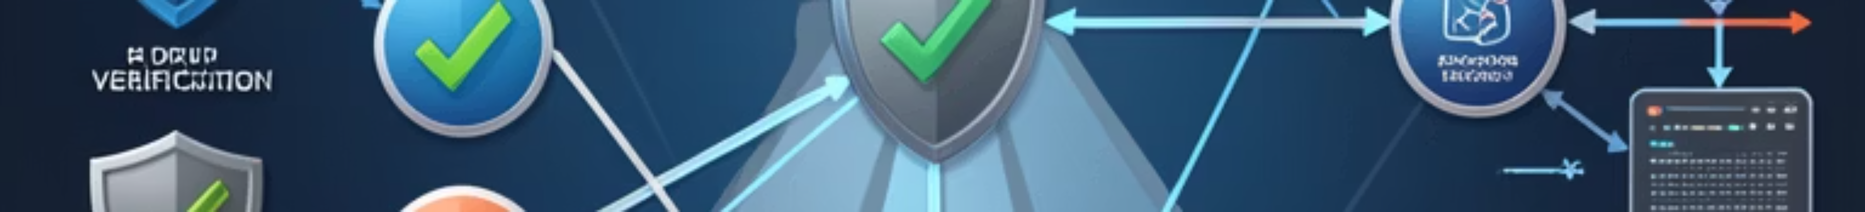
Conclusion & Roadmap
What We Built — and Where We're Headed
What We Accomplished
Future Enhancements
Built a fully functional multi-modal AI integrity system
Three independent classifiers: text, UX, and image
Unified Integrity Score with interpretable trust bands
Combined NLP + Deep Learning + Computer Vision
Deployed as an interactive Streamlit application
01
BERT Integration
Replace bag-of-words with transformer-based embeddings for state-of-the-art fake news detection accuracy.
02
Grad-CAM Explainability
Add visual heatmaps to highlight which image regions triggered the deepfake classification improving transparency.
03
Cloud Deployment
Host as a scalable web service with API endpoints for integration into browsers, CMS platforms, & content pipelines.
04
Real-Time Browser Plugin
Extend Integrity Agent into a browser extension for live, passive scanning of web content as users browse.

